Slide 1

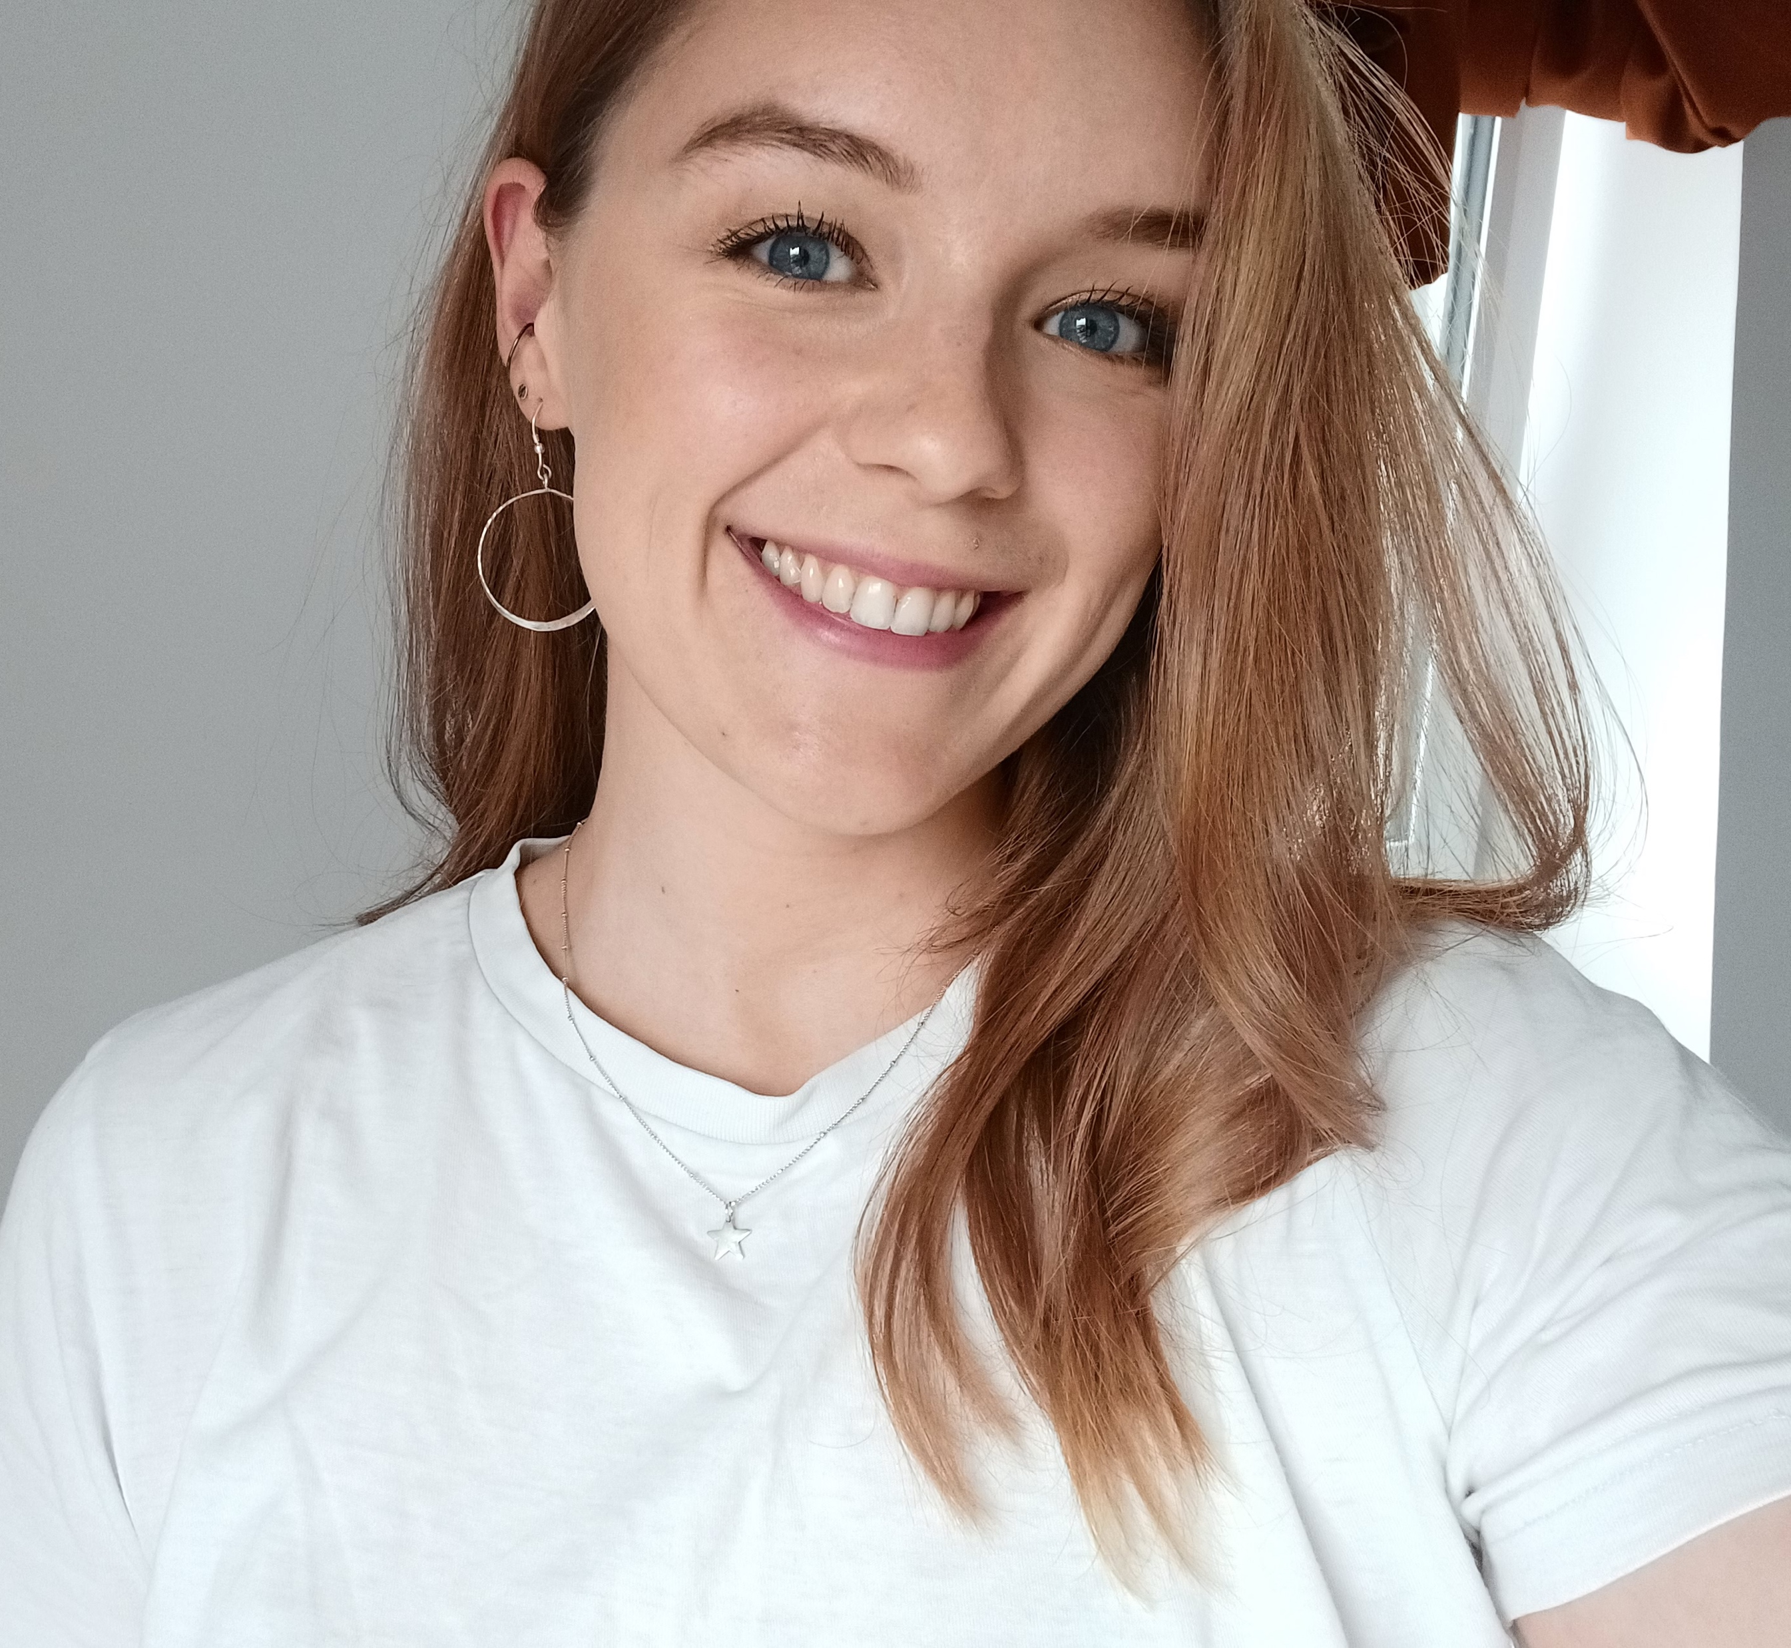
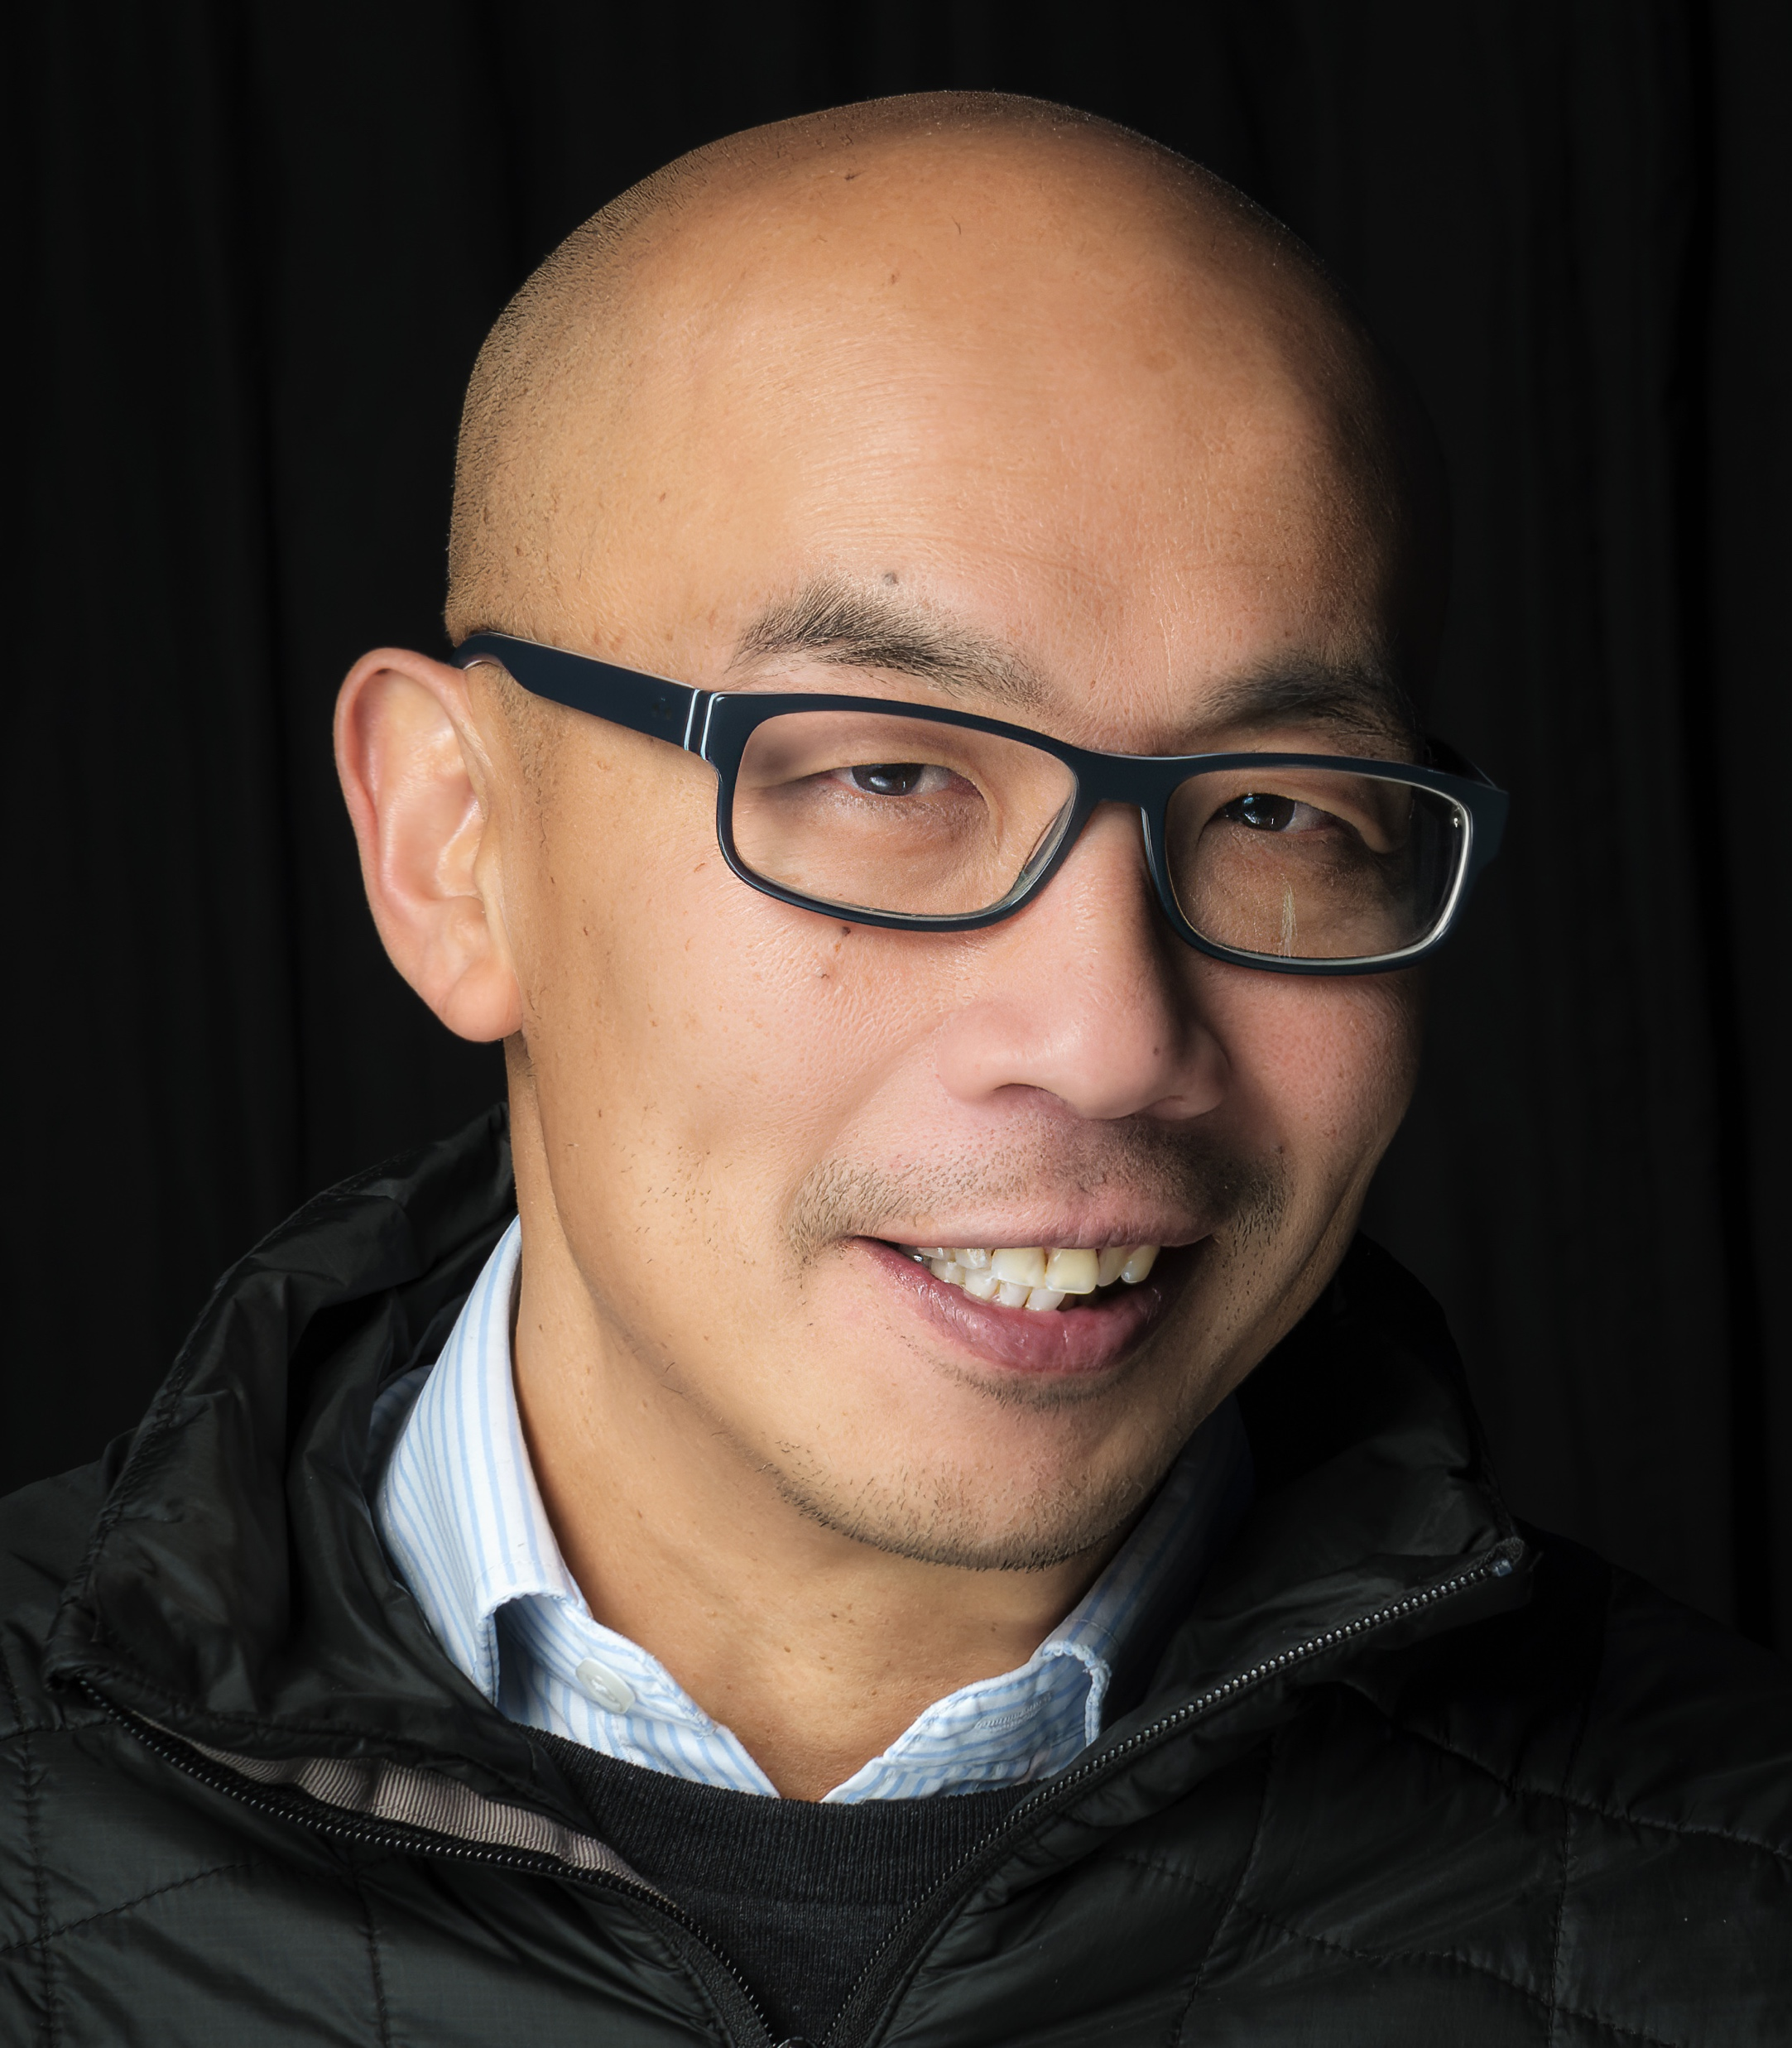

Handing over the reins of research to the patients: Our journey to 100% patient-led research
Professor Gwo-tzer Ho
Miss Molly Halligan
CCUK Patient Research Open Day
18th November 2024
Notes:
Introduce both of us – explain that we want to have patients involved in guiding future research.

Slide 2
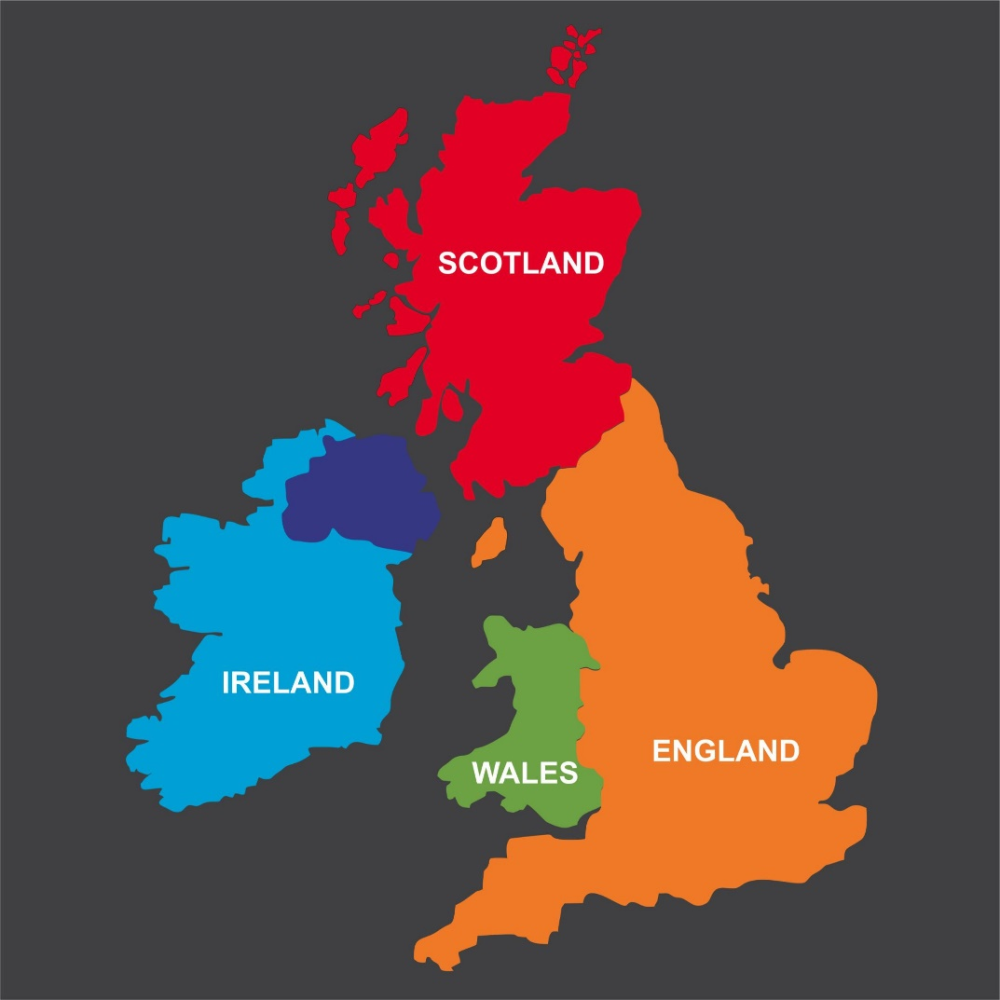

Our Research
Scottish Translational Gut Research Network (STAR)
Investigator-led Clinical Trials
Glasgow, Edinburgh and Dundee
5 collaborative STAR projects in Scotland (2019-present)
MARVEL & MiniMARVEL RCT in UC
BIOPIC in Crohn’s disease
FATE-CD in Crohn’s disease
GUT RESEARCH UNIT
Biomarker & Technologies
Immunology
Mitochondrial DAMPs: Host Danger signals
IBD Sense: Molecular probes in IBD
FATE-CD: Tracking and imaging fibrosis in CD
Multi-protein profiling using PEA-technology
~2000 patients have taken part
in our research since 2019!
Macrophage in IBD
Th17 and cathelicidins in Crohn’s disease
Mitochondrial DNA and Immune signaling
NET-formation in IBD
‘All-Ages’ Research
Microbiome
Science + Clinical in Paediatric IBD
MiniMUSIC, MiniMARVEL and PINPOINT
Across UK
Oral-Gut microbiome Axis
M-cells and bacterial handling
Fibrosis & Metabolism
Novel Tissue Repair
Fibrosis-associated protein (FAP)
Hypoxia inducible factor-1
Ketogenic pathway in UC stem cells
Human Intestinal Organoids in IBD
Improving Mitochondrial Function
Blocking Host ‘Danger Signals’
Macrophage-monocytes in the Inflamed Gut
Immunometabolism
Our Unique BioResource
IBD Gut Pipeline
Multi-omic + Metadata

Slide 3
How I became involved in Patient Involvement and Engagement work
What is the impact or relevance to the patient?
Do they even know or care?
What do I actually do to engage and involve patients? I had no idea!

Slide 4


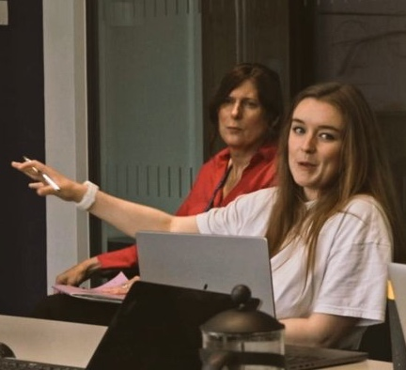
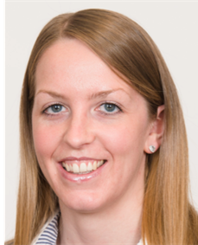
Our 1st Patient Group
‘They came to me!’
Jon
Molly
Kris G
Kris M
2017

Slide 5
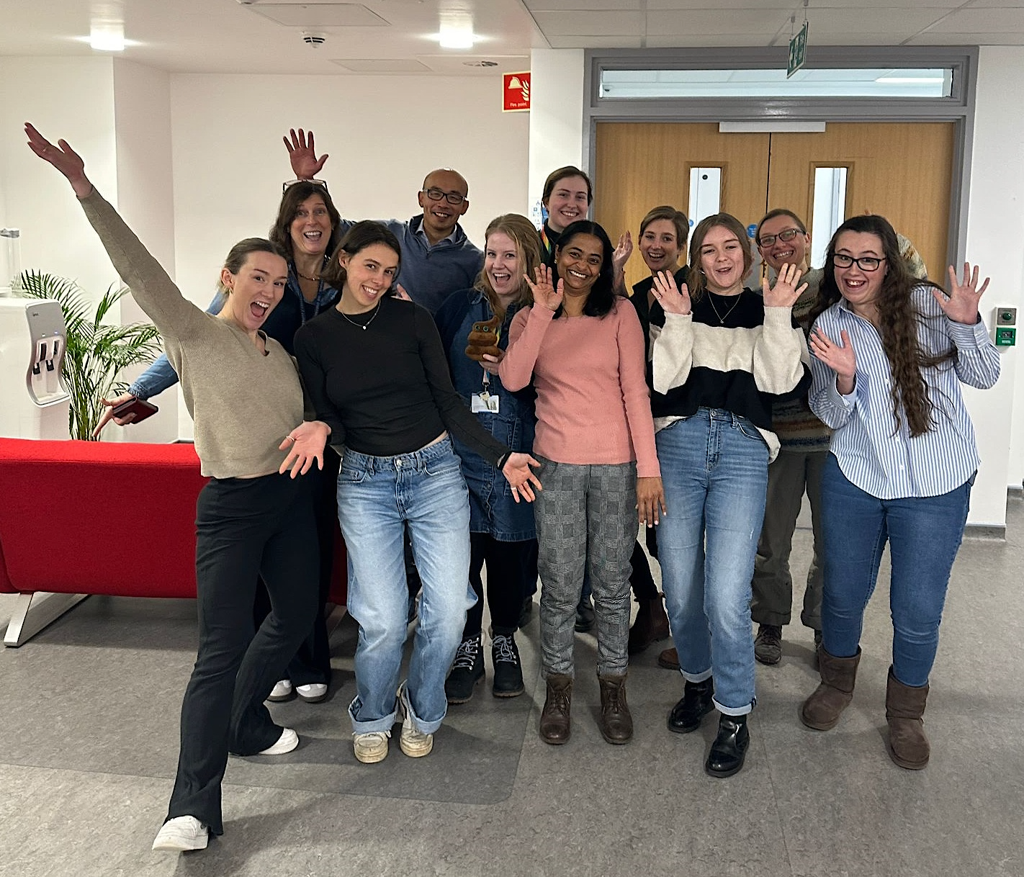




And today!

Slide 6
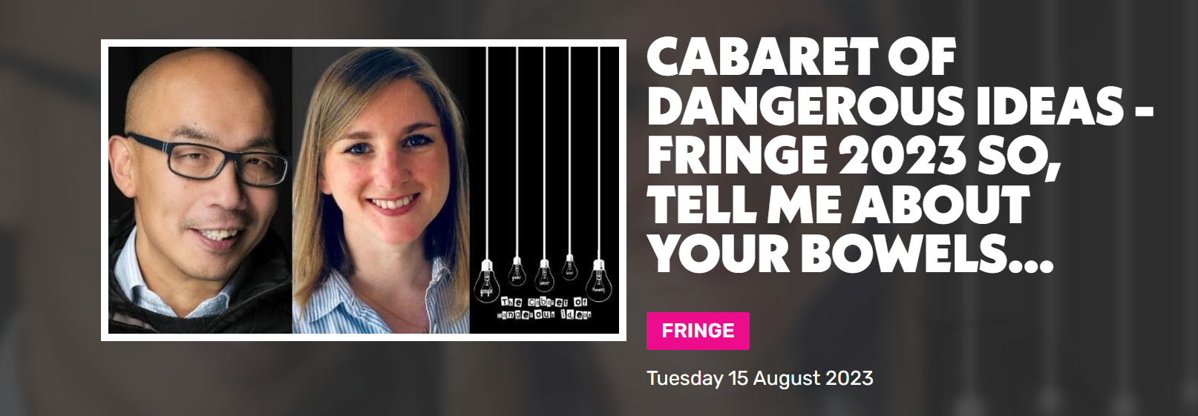

Breaking down the stigma about talking about bowels!

Slide 7
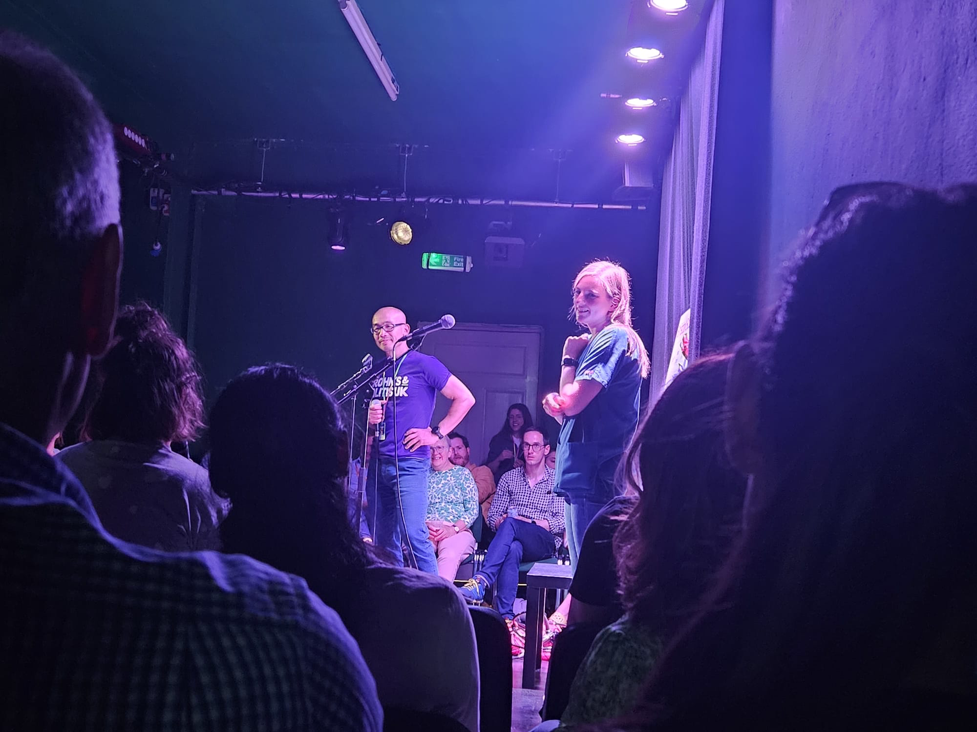
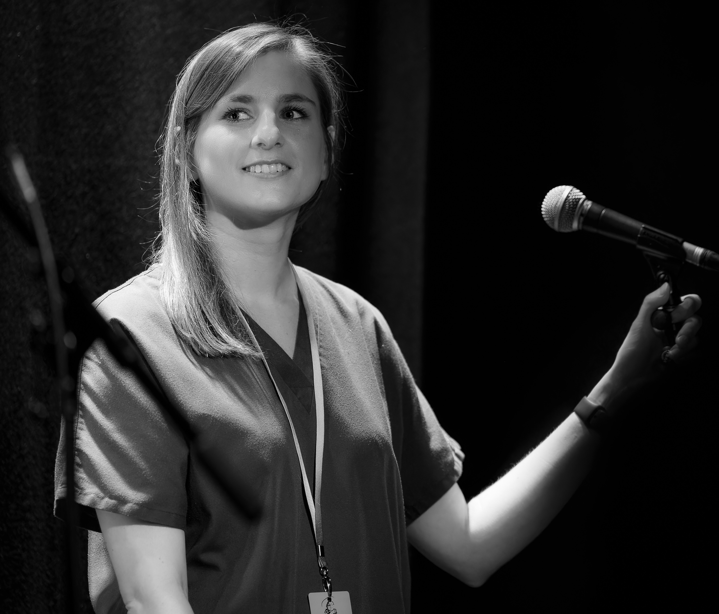
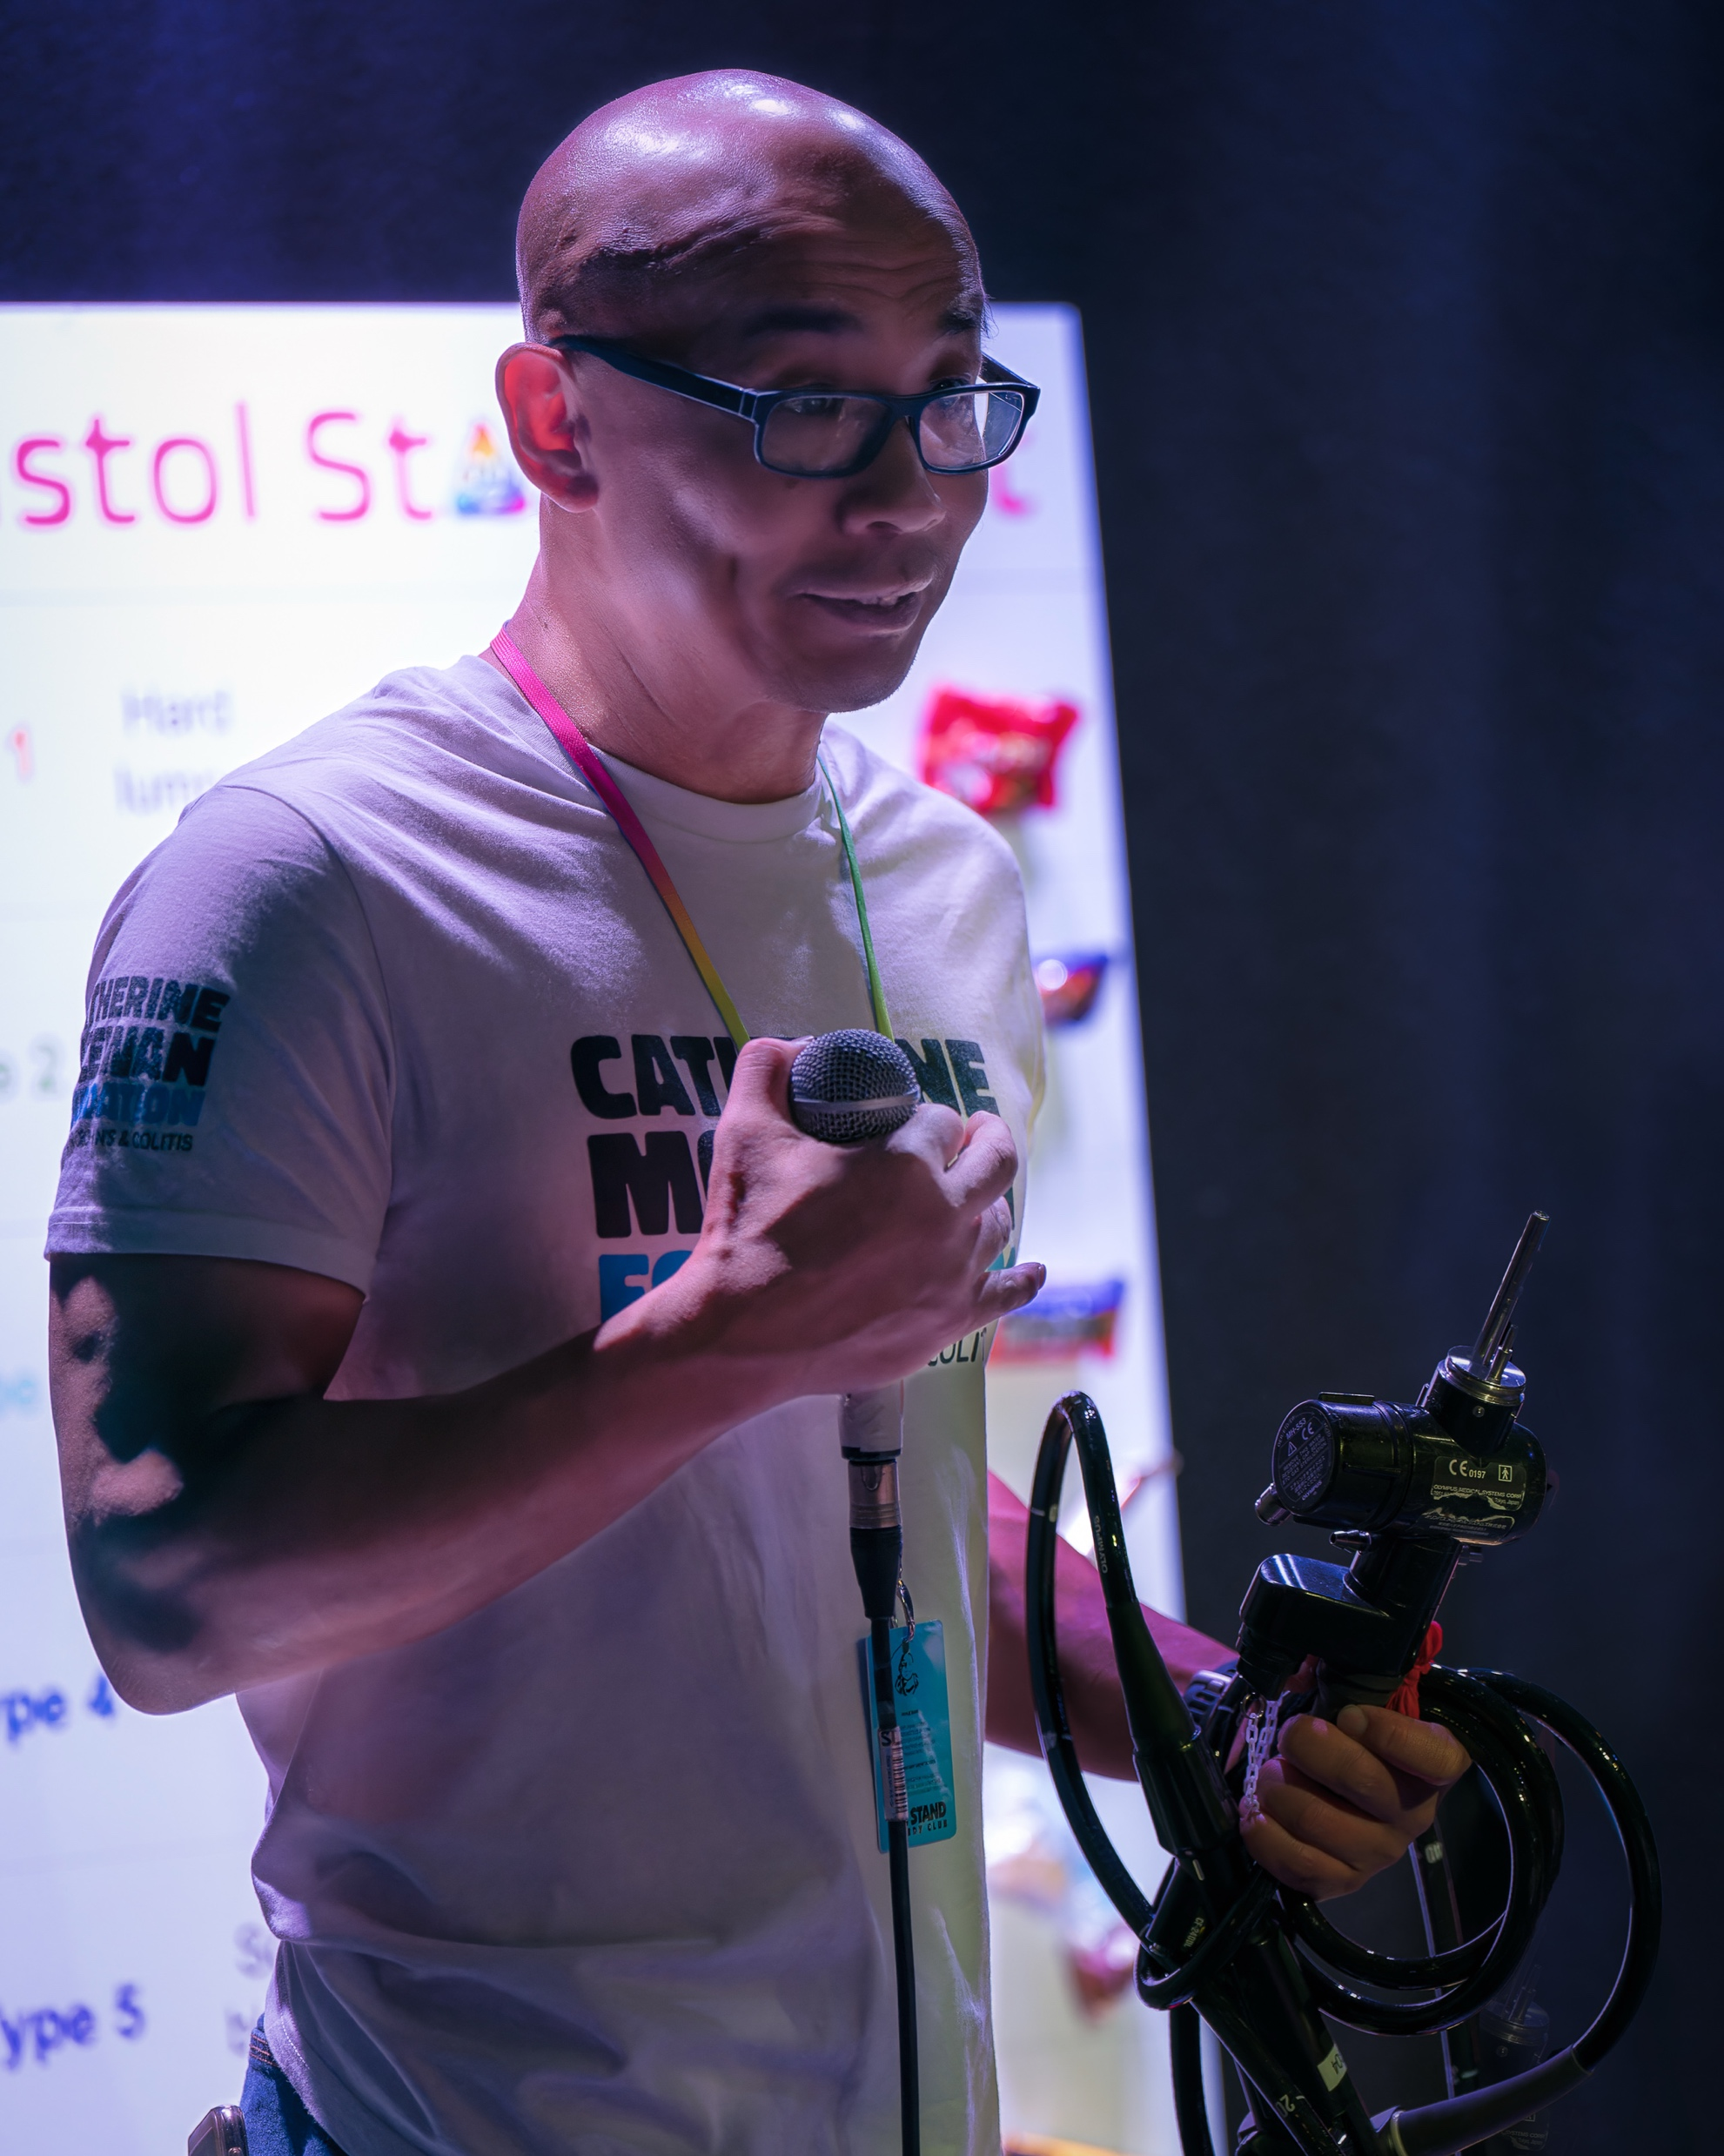
2 Sell-Out Fringe Shows!!!

Slide 8
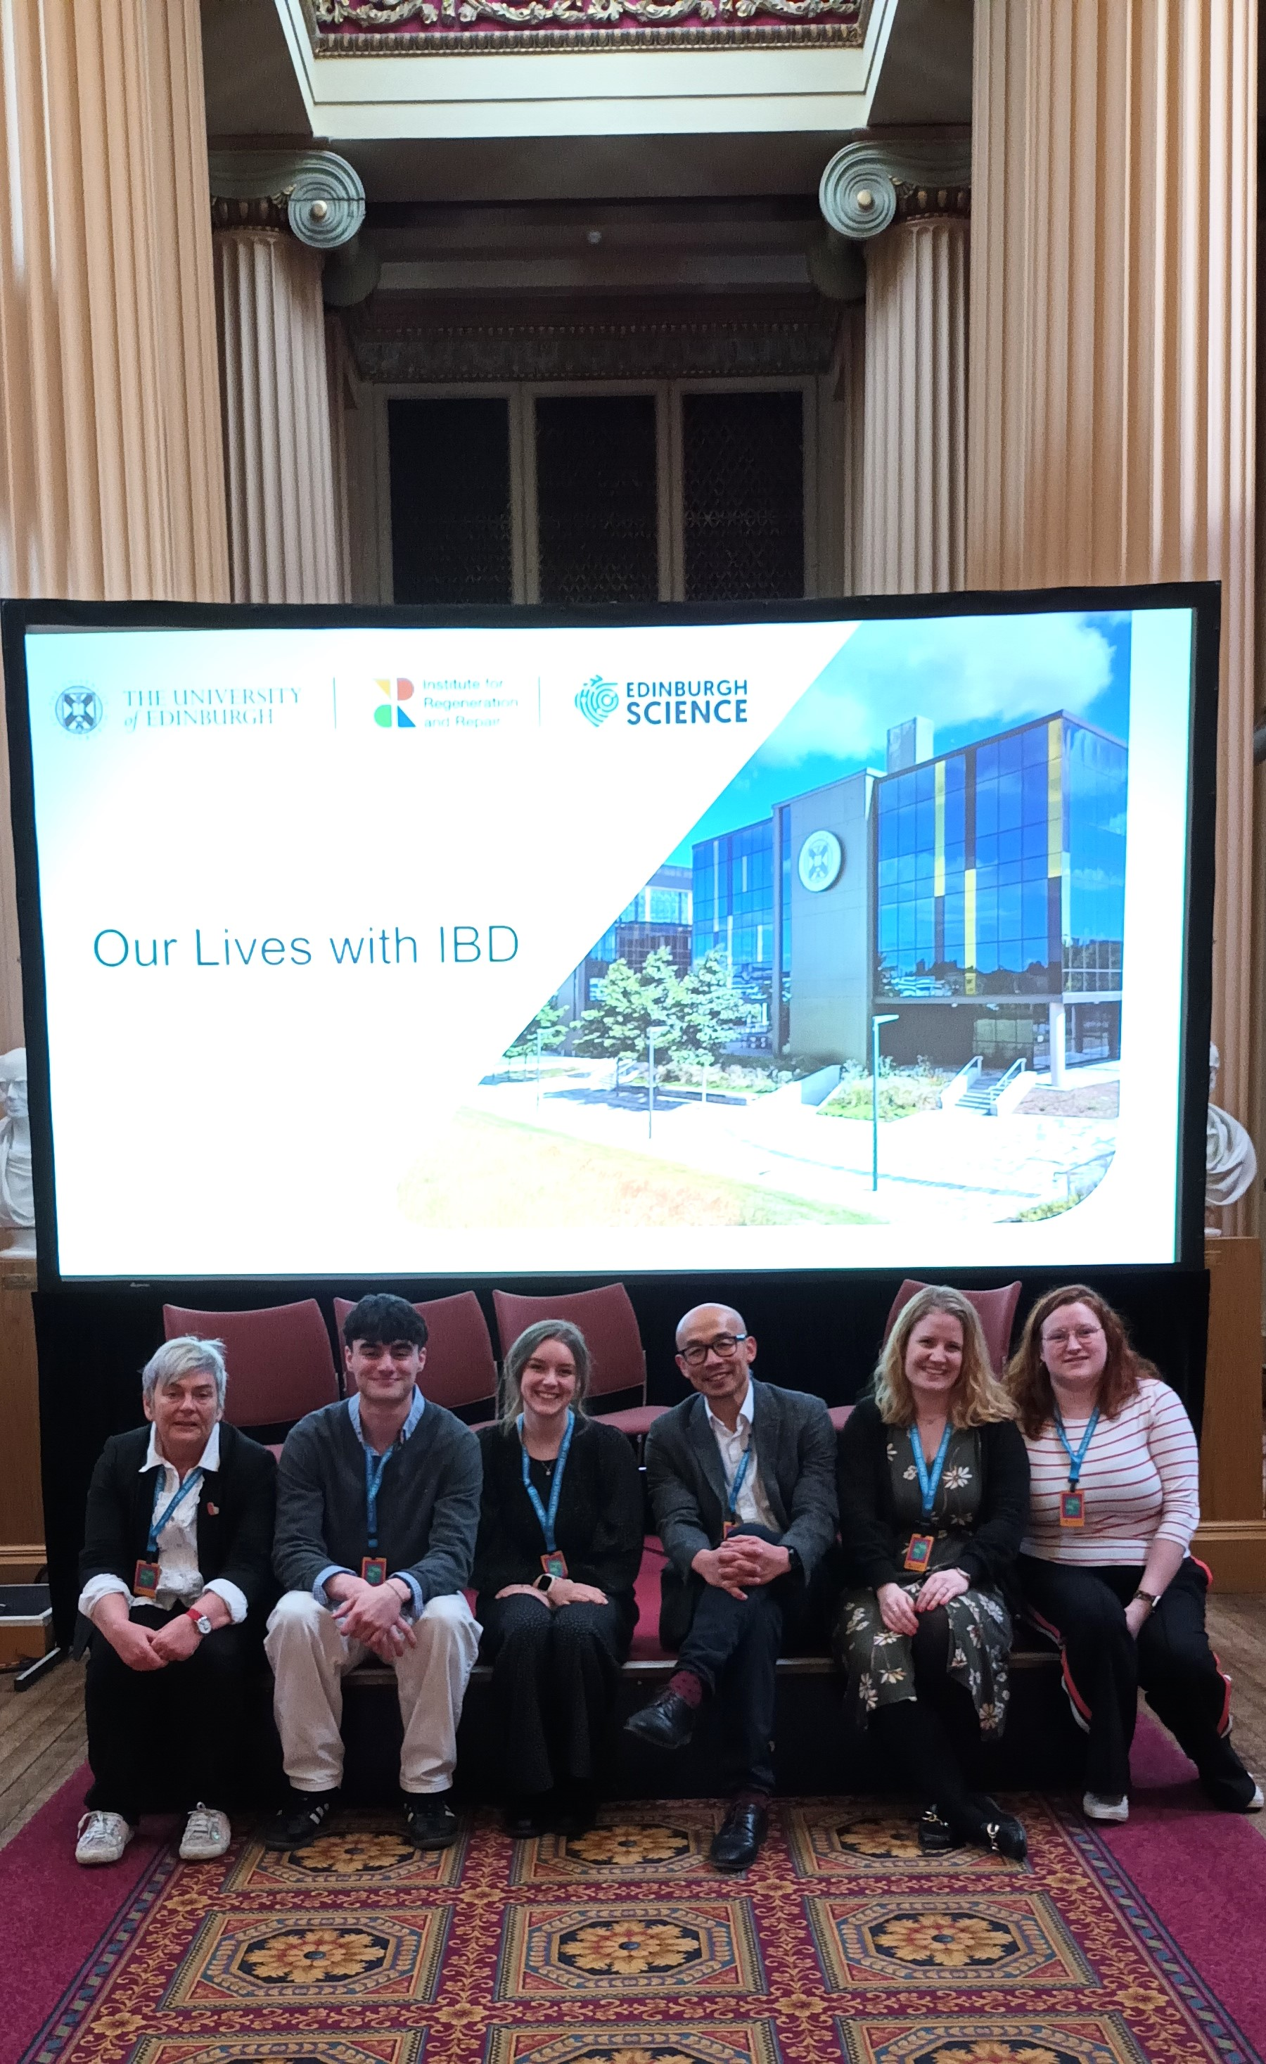
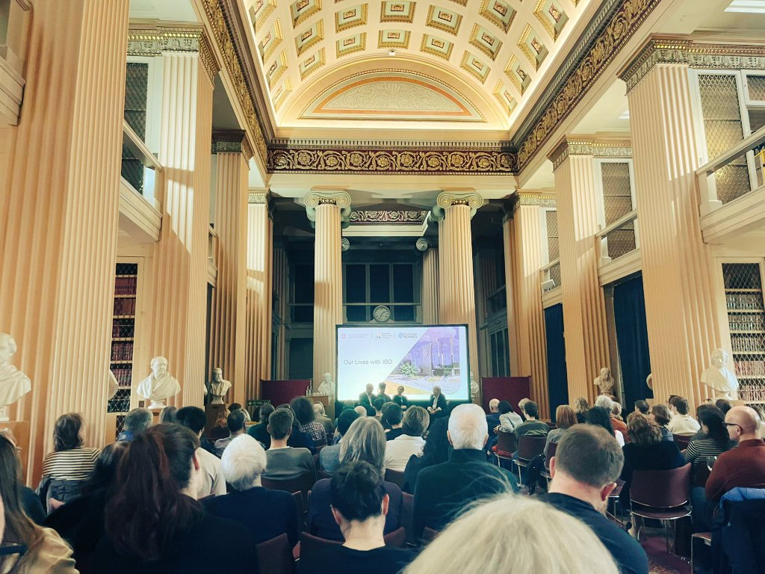
‘Our Lives with IBD’
Edinburgh Science Festival 2004

Slide 9
Patient involvement impact on our research: Some recent examples
MARVEL clinical trial – Mitochondrial antioxidants in UC (www.marvelstudy.uk)
MUSIC – Mitochondrial DAMPs biomarkers in IBD (www.musicstudy.uk)
FATE-CD – PET/MRI scanning to detect/measure ‘scarring’ (fibrosis) Crohn’s
IBD Sense – Granzyme B biomarker in IBD
MiniMUSIC – Paediatric Crohn’s mitochondrial DNA
Patients providing input and direction, ~£10 million funding from UKRI/MRC, Wellcome, Helmsley Trust, CCUK, Chief Scientist Office.
2023-present

Slide 10

My thoughts of PPI….
Clinician-scientist-led PPI (Good)
Co-production led PPI (Better)
Molly suggested in 2023 - ? Patients on the wheel
Patient-led PPI (Mind-blowing!!)

Slide 11
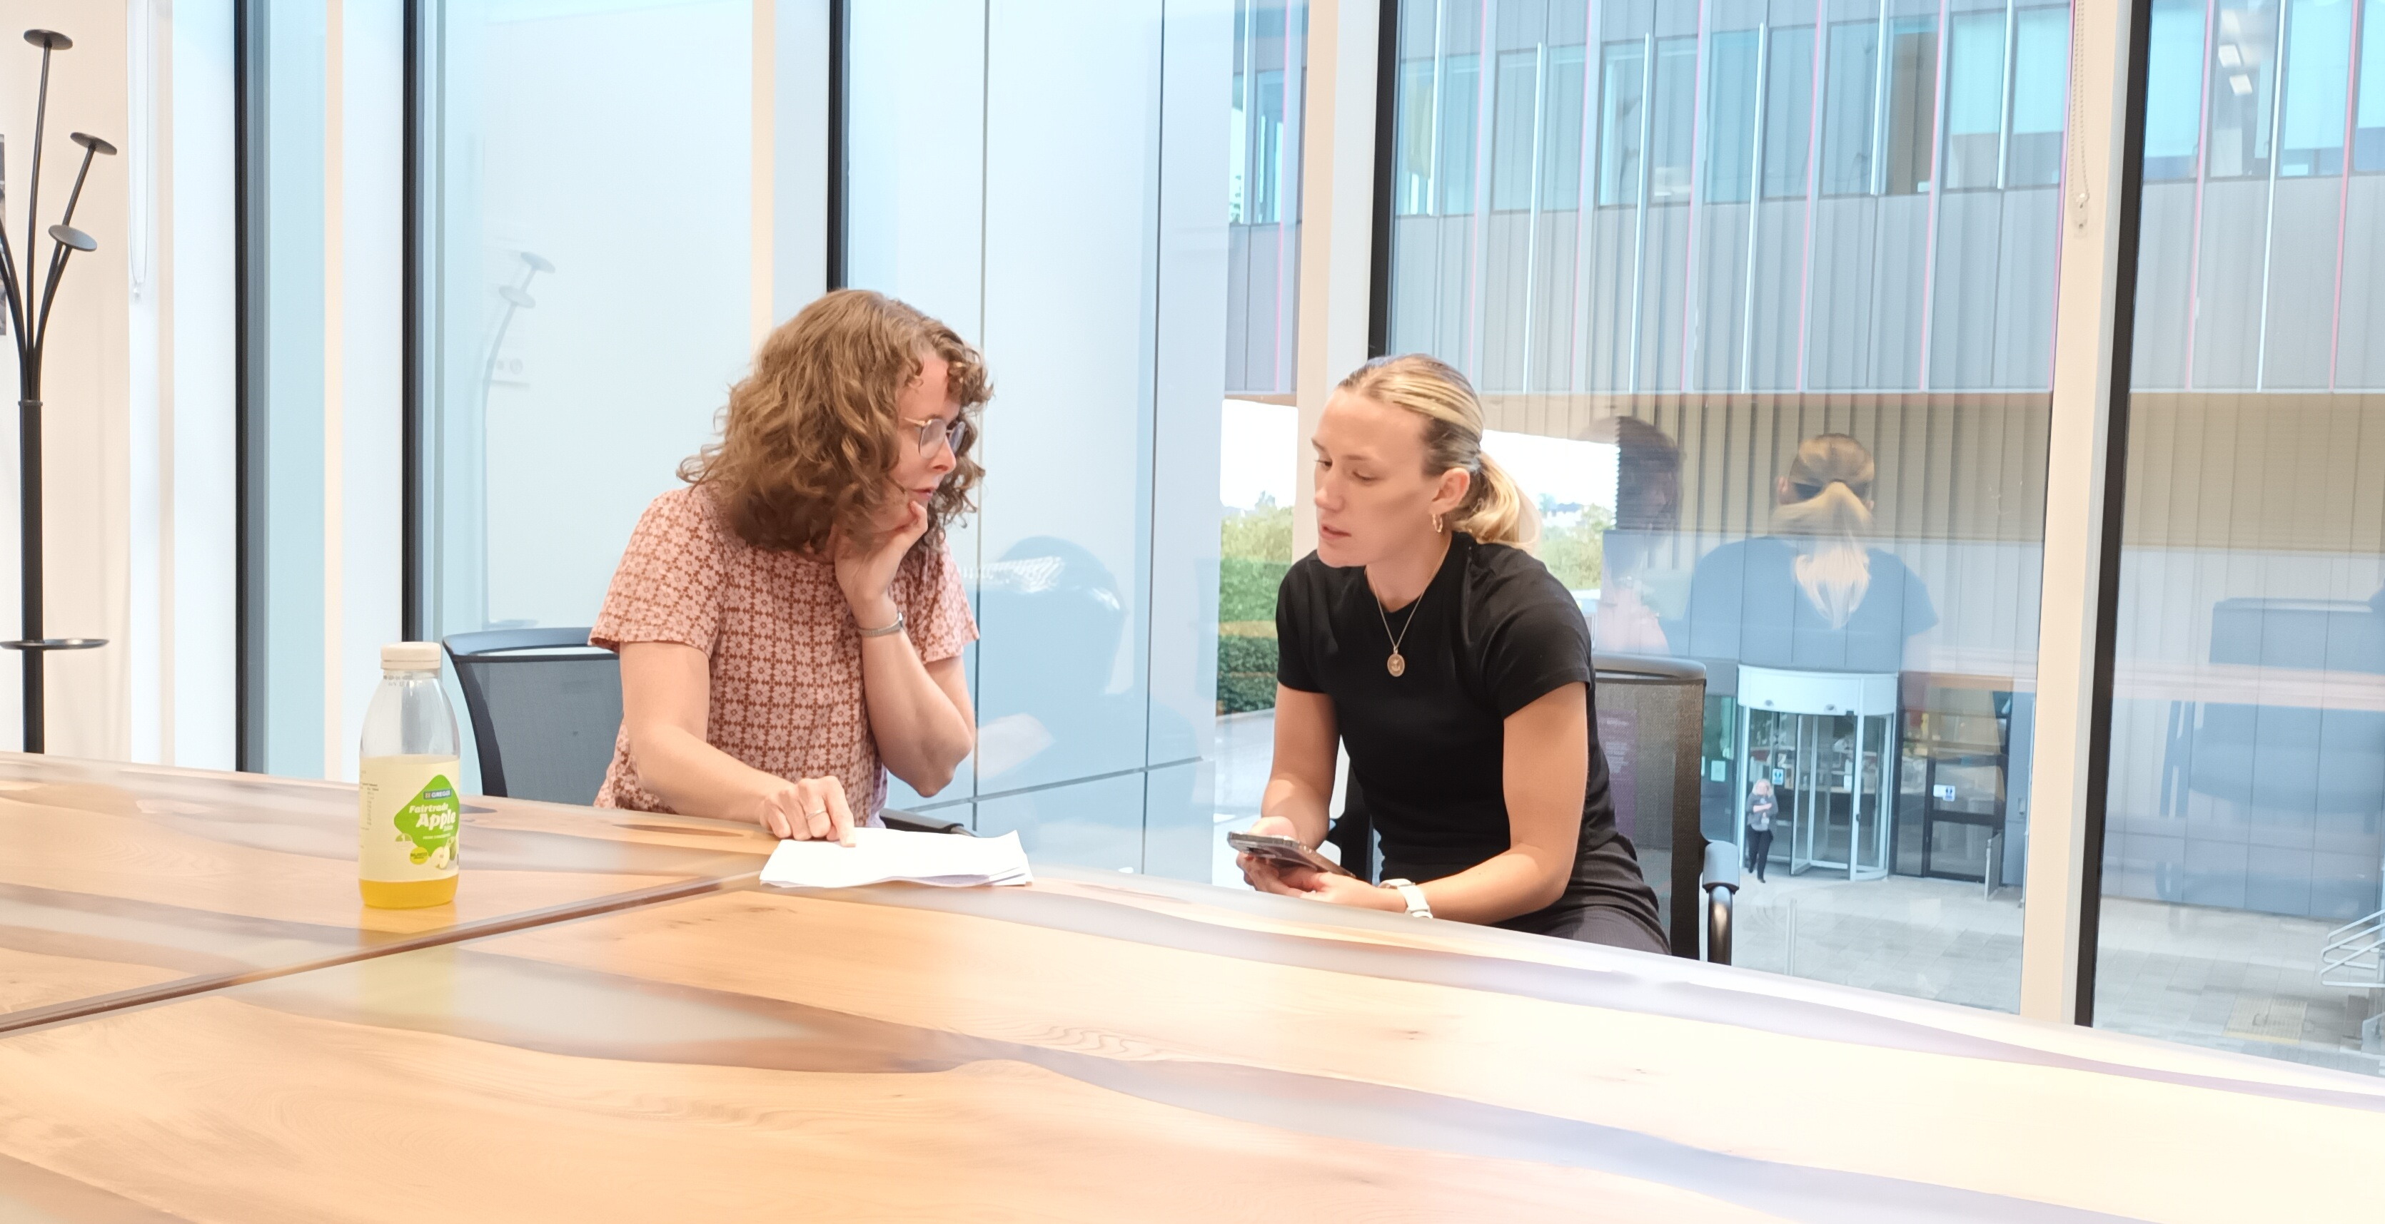
Conversations with Tricia and Emma: Our journeys in IBD
Low hanging fruit for Patient-led Work!
Content 100% developed by our 2 CCUK Research Champions

Slide 12
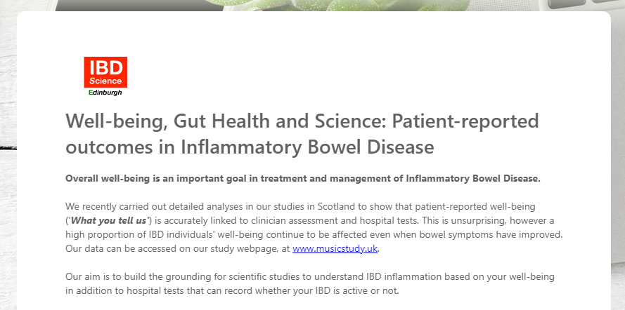
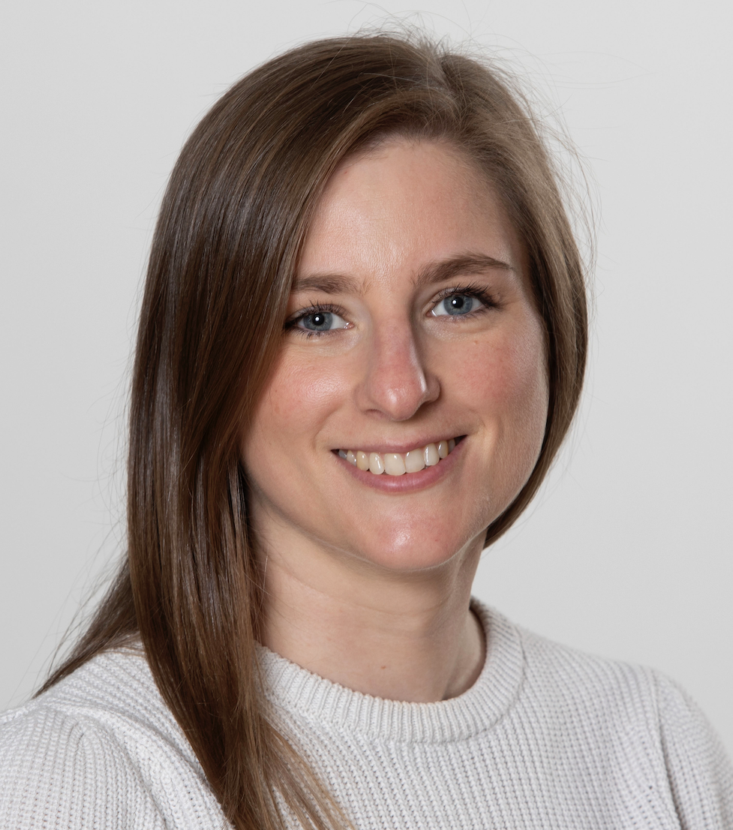
Last year (2023) – 1700 patients from UK took part in our survey!
We wanted to build the scientific platform to
understand fatigue associated with IBD
Rebecca Hall

Slide 13
Poor quality of life and fatigue despite medical therapy:
Can we predict IBD-associated fatigue?
Full paper almost ready, and will be accessible to patients!

Slide 14
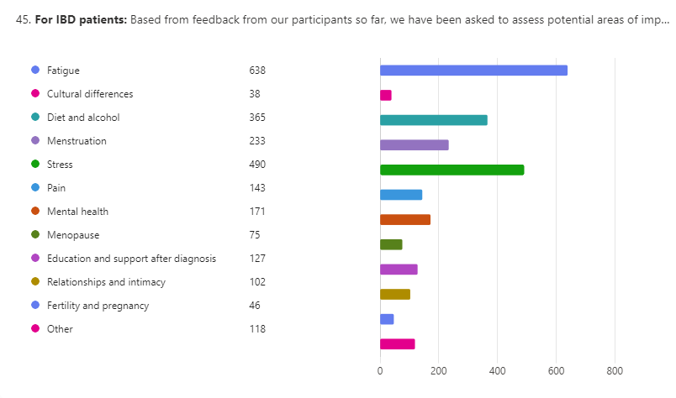
Patients have different perspectives….from say, clinicians!

Slide 15
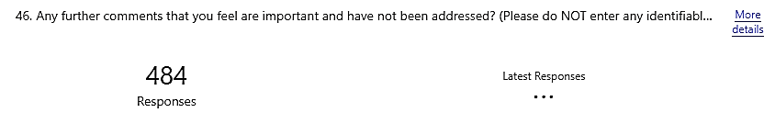
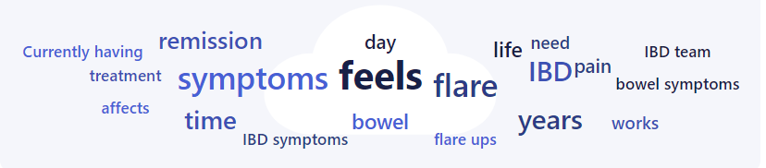
A section where ‘you, the patients, convey your views, insights and experiences…’
‘Dear Molly, can you help us here?’

Slide 16

Close to 500 detailed comments and my thoughts….
These messages should not be in vain
Patients’ views should be represented by patients
Can we trust them?
Can we hand over the reins?

Slide 17



Taking the Reins
New type of PPI work for our group
The Public Patient Involvement (PPI) group
Contributing our own experiences
Ensuring all of our voices were heard

Slide 18
What did we want to learn?
What are the priorities around research and wellbeing from the perspective of survey respondents and the PPI group?
How do patients analyse, present and communicate patient reported concerns of wellbeing and experience with IBD?
How do we make this process more transferrable for future projects (specifically, how to make this appealing to clinical researchers)?

Slide 19

What did we do?
Priority Areas
Meetings
Writing

Slide 20
Quality of Life
Priorities
What Does ‘Remission’ Mean
Impact of Additional Conditions
Cost of and Access to Care
Mental Health
Extraintestinal Manifestations of IBD Symptoms
Women’s Health and Reproduction
Body Image
Self-Management of IBD
Awareness and Knowledge about IBD
Exhaustion and Fatigue
Experience with Stomas
Age

Slide 21
What did we learn?
Contributing your experience to clinical-research is worthwhile
The value of the patient voice and PPI groups
Interconnected issues of Wellbeing and IBD
Reflections from the PPI group on the process itself
Transferability to other groups
There is always more to understand..
Priorities for research, but what now?

Slide 22

Final thoughts
Two papers in Jan 2025: One Clinician-led and another, Patient-led….
Molly and team’s paper is outstanding and vividly novel, ‘not seen before!’
With the ‘soul of the patients’, written by the patients and for all.
Next step?......Totally new.

Slide 23
Thank You!

